Slide 1
NEPR208 Synapses, plasticity and learning
Synaptic depression and adaptation
Synaptic facilitation and working memory
Spike time dependent plasticity and long term memory
Heterosynaptic long term depression and network stability
Network learning of motor patterns in birdsong – Hannah Payne

Slide 2


The visual system adapts to the mean luminance

Slide 3

The visual system adapts to the mean luminance

Slide 4
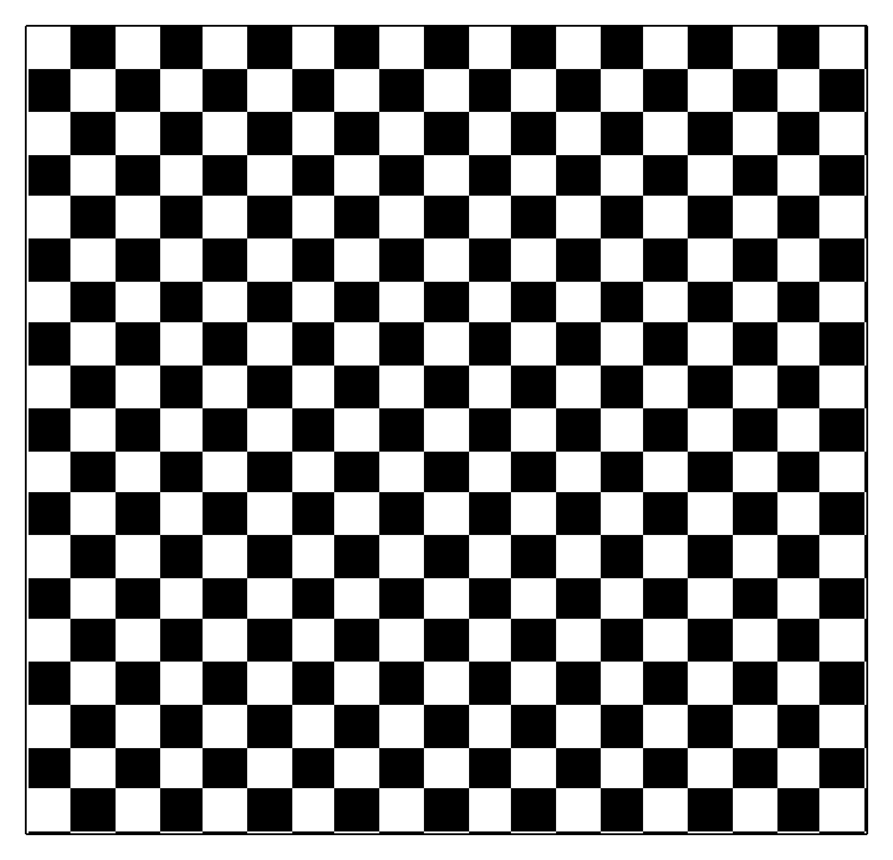

The visual system adapts to contrast

Slide 5
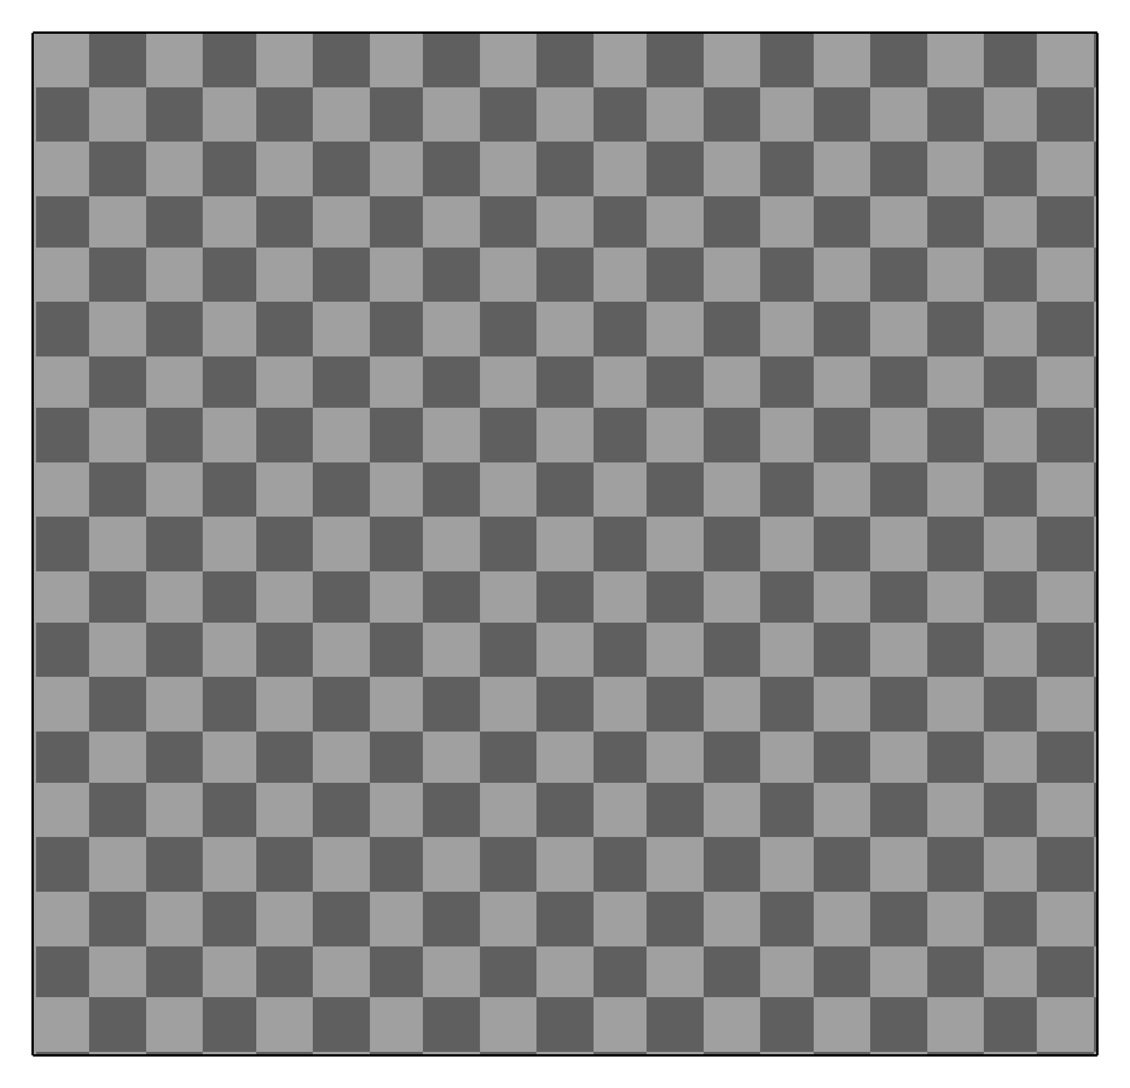
The visual system adapts to contrast

Slide 6


Functional importance of adaptation
Luminance adaptation
Contrast adaptation
Blakemore & Campbell, 1969
Shapley & Victor, 1979
Smirnakis et al., 1997

Slide 7
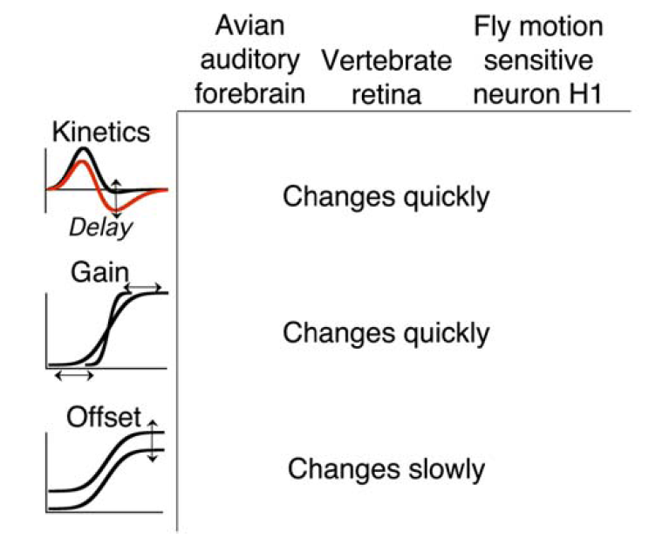
How can a neural circuit compute a higher-order statistic, and
how can it change response properties?
Common properties of contrast adaptation
Change quickly
Changes quickly
Amplitude
Changes slowly
Nagel & Doupe, 2006
Fairhall et al., 2001

Slide 8
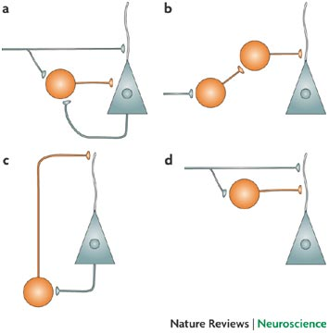
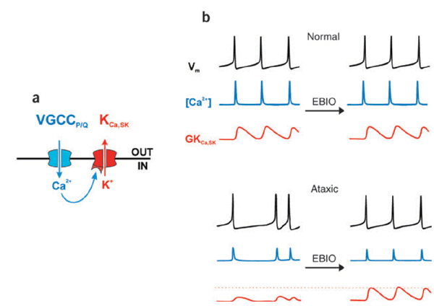
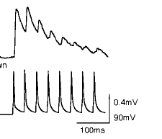
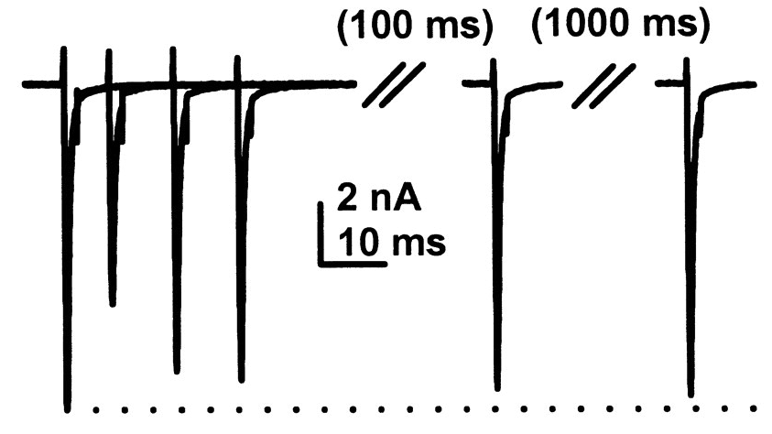
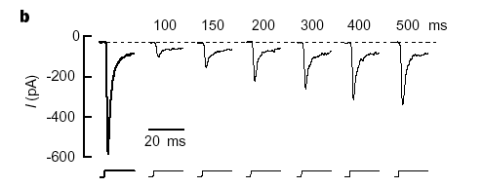
Change in sensitivity by modulation
Feedforward inhibition
Feedback inhibition
Spike dependent conductances
Change in sensitivity by depletion
Ion channel inactivation
Short-term synaptic plasticity
synaptic depression
Receptor desensitization
Post
Pre

Slide 9
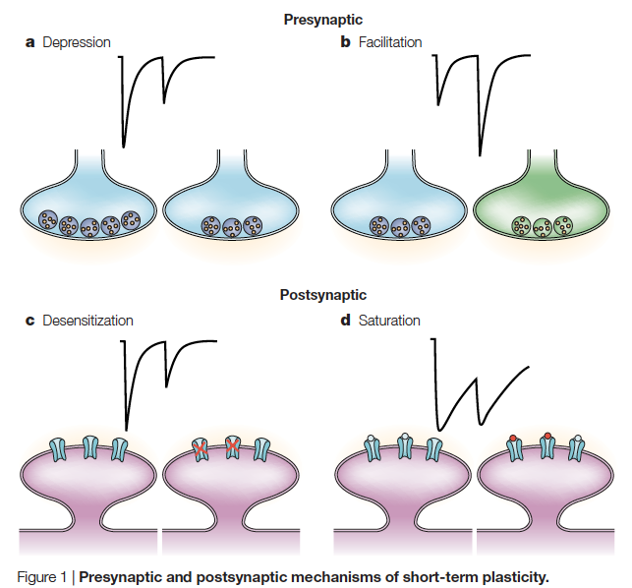
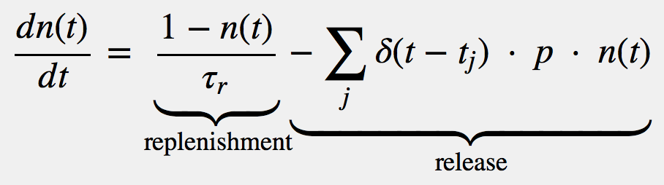
Short-term synaptic plasticity – synaptic depression
Post
Pre
Depletion of available vesicles as a mechanism for depression
n: Number of vesicle
p: Probability of vesicle release
Release = n x p
Hennig, 2013. Theoretical models of synaptic short term plasticity

Slide 10

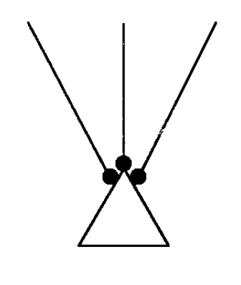
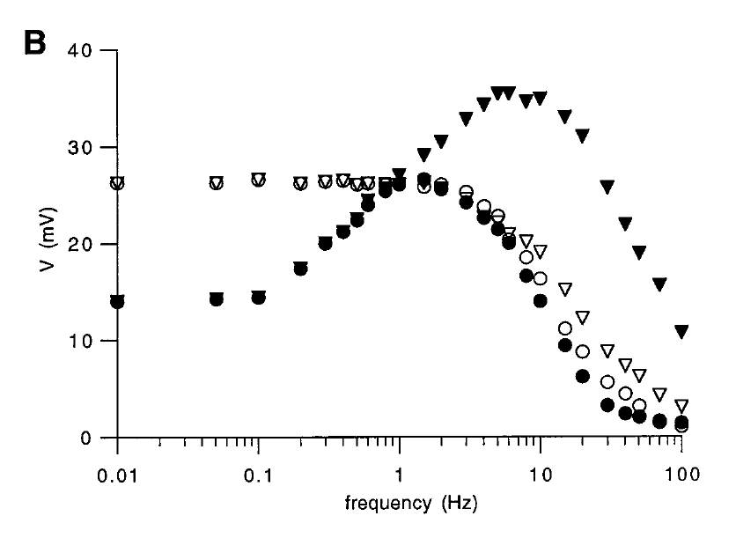
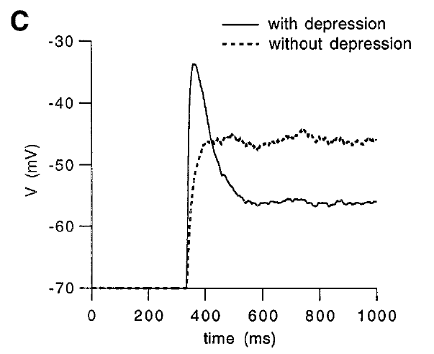
Contrast adaptation and a model of synaptic depression
Single spike depressing
not depressing
Spike trains depressing
not depressing
Synaptic depression and the temporal response characteristics of V1 cells.
Chance FS, Nelson SB, Abbott LF. (1998)

Slide 11
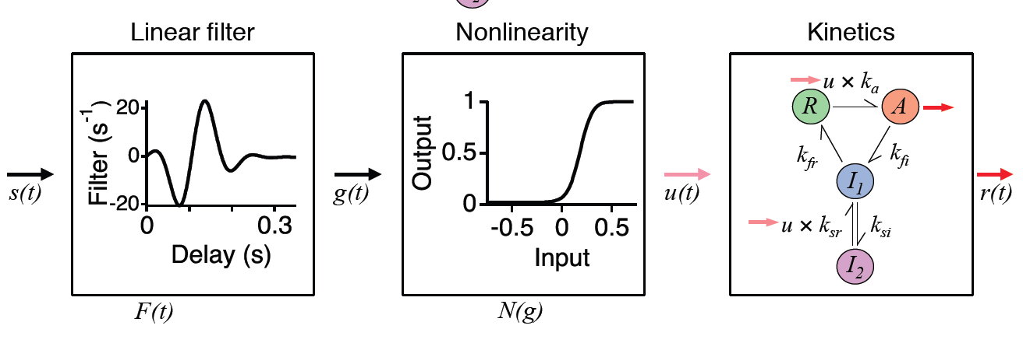
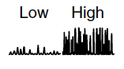
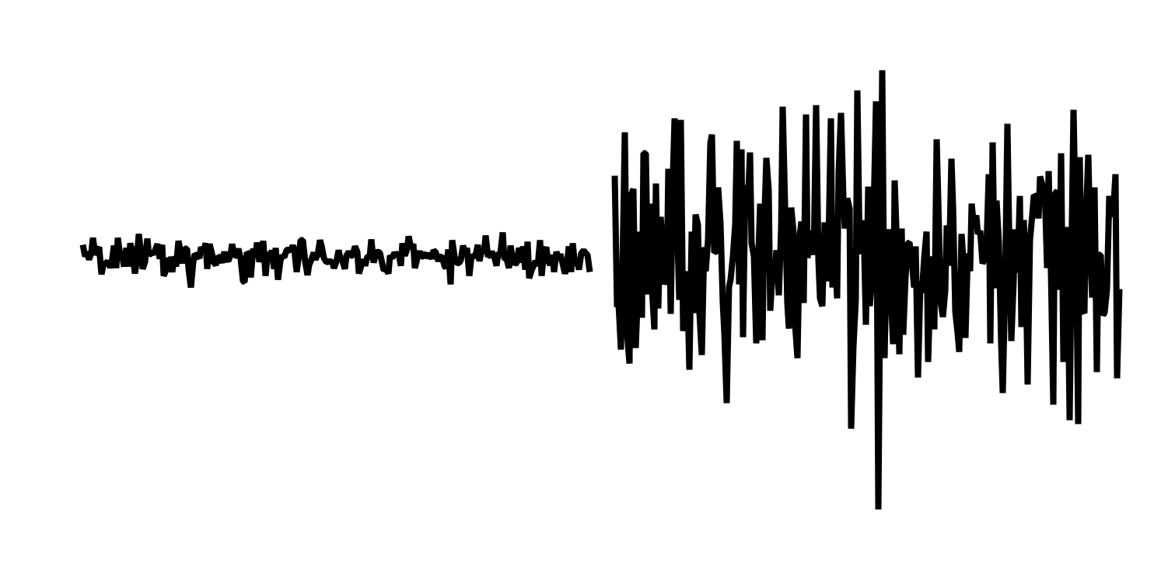
Biophysical model of contrast adaptation
Low High
Low High
Ozuysal & Baccus (2012)
Notes:
Model combining a standard LN model with a first-order kinetic model of the type used for ion channels and receptors. We have discussed a two-state version of such a kinetic model. Rate constants define transitions between a resting state (R), an active state (A), and two inactive states (I1 and I2). The input to the kinetic model is a rate constant, the output is the active state. Although the kinetic model is abstract, the states were found to map onto previously measured kinetic properties of bipolar cell ribbon synapses.
Mechanistically, the nonlinearity of the model (from previous known information about the circuit) is likely to be calcium channels in the bipolar cell presynaptic terminal. This is because bipolar cells do not strongly adapt, but the ganglion cell membrane potential does.
The threshold converts a signal that changes in amplitude s(t), to one that changes in its mean value, u(t). So contrast adaptation is really adaptation to the mean of a thresholded (rectified) signal. In other words the synapse is only adapting to the mean of its own input, but a change in mean occurs when the contrast changes. This adaptation at the bipolar cell synapse yields the adapted output r(t).
This correspondence between computational properties of adaptation and known properties of synaptic release suggests a function for the different vesicle pools. The readily releasable pool may be small to cause rapid changes in gain. Vesicles may change pools slowly in order to integrate over the recent stimulus to cause prolonged adaptation.

Slide 12
The LNK captures membrane potential responses
Contrast (%)
Data
Model
28
5
12
20
8
35
12
34
24
16

Slide 13
Biophysical model of contrast adaptation
Low High
Low High
Voltage-dep.
Ca channel
Reserve pool
Recycling
pool
Readily
releasable pool
Ozuysal & Baccus (2012)
Notes:
Model combining a standard LN model with a first-order kinetic model of the type used for ion channels and receptors. We have discussed a two-state version of such a kinetic model. Rate constants define transitions between a resting state (R), an active state (A), and two inactive states (I1 and I2). The input to the kinetic model is a rate constant, the output is the active state. Although the kinetic model is abstract, the states were found to map onto previously measured kinetic properties of bipolar cell ribbon synapses.
Mechanistically, the nonlinearity of the model (from previous known information about the circuit) is likely to be calcium channels in the bipolar cell presynaptic terminal. This is because bipolar cells do not strongly adapt, but the ganglion cell membrane potential does.
The threshold converts a signal that changes in amplitude s(t), to one that changes in its mean value, u(t). So contrast adaptation is really adaptation to the mean of a thresholded (rectified) signal. In other words the synapse is only adapting to the mean of its own input, but a change in mean occurs when the contrast changes. This adaptation at the bipolar cell synapse yields the adapted output r(t).
This correspondence between computational properties of adaptation and known properties of synaptic release suggests a function for the different vesicle pools. The readily releasable pool may be small to cause rapid changes in gain. Vesicles may change pools slowly in order to integrate over the recent stimulus to cause prolonged adaptation.

Slide 14
u × 43
R
A
6
7
I₁
u × 0.01
0.4
I₂
Threshold converts amplitude to mean
Gain
Change in rate constants change kinetics
Output
Depletion of resting state changes sensitivity
Inactivated states act as buffers

Slide 15
Theoretical explanations for biophysical properties
Temporal filtering
Ca
Reserve pool
Recycling
pool
Ca
Amplitude
Reserve
Recycling
RRP
Readily
releasable pool
Why does the readily releasable pool deplete?
To produce large changes in gain.
Why have a recycling pool?
To give distinct dynamics for fast and slow adaptation.
Why is the reserve pool so large?
This may be a natural consequence of slow adaptation.
Why is slow vesicle movement calcium dependent?
This may set the slow adaptive timescale.

Slide 16
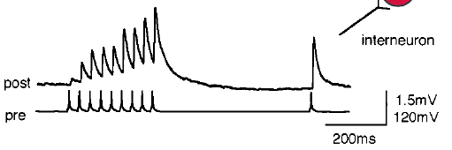
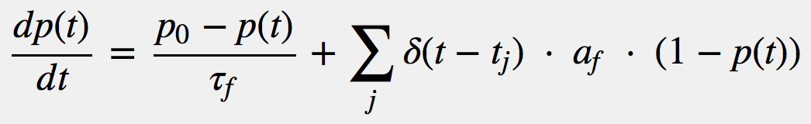
Short-term synaptic plasticity – synaptic facilitation
Residual calcium as a mechanism for increased release

Slide 17
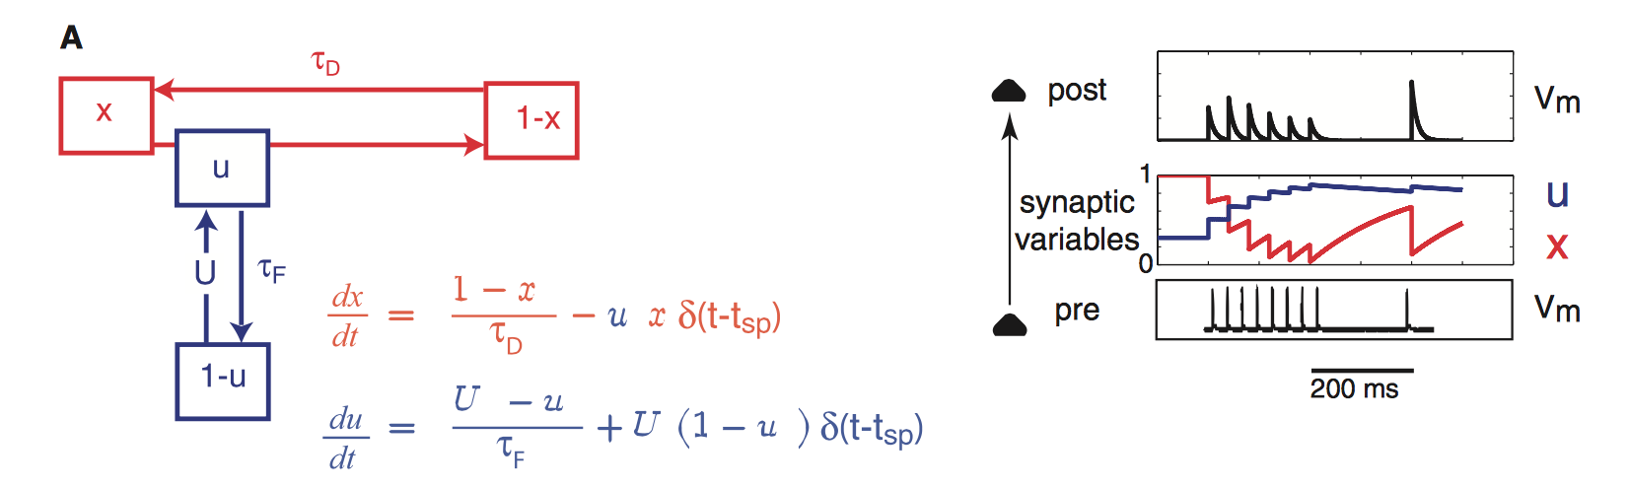
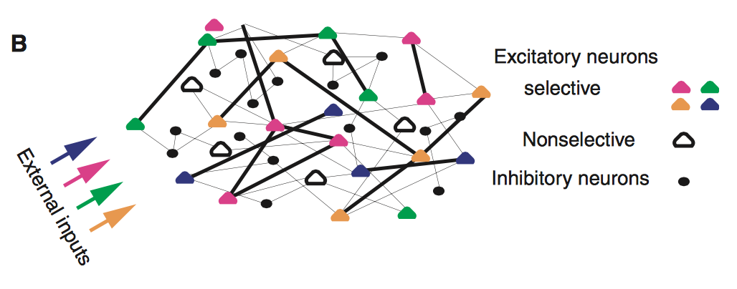
Proposal for synaptic facilitation in short-term memory
x : ~ N (vesicles)
U : ~ p (release probability
Release & Replenishment
Facilitation
Synaptic theory of working memory
Mongillo, Barak & Tsodyks, 2008

Slide 18
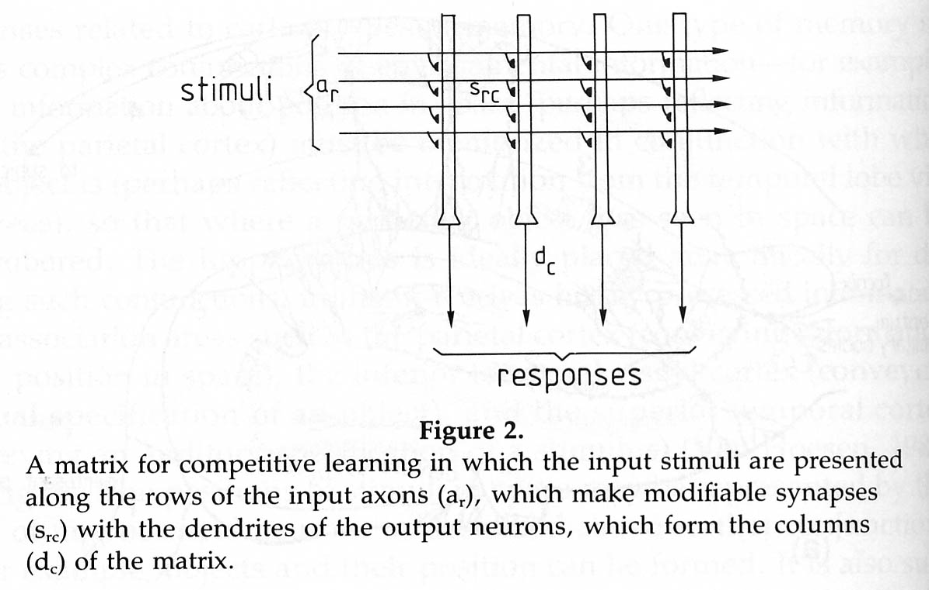
Synaptic transmission as a matrix multiplication
X
W
Input X, column vector
Output Y, column vector
Matrix of synapses W
n
m
m
1
n
Y
1
W
X
Y
m
=
m
n
n
1
1

Slide 19
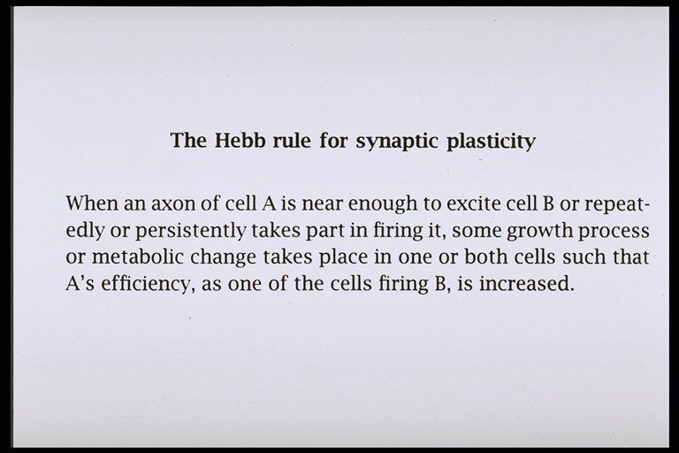
A
B
Hebbian plasticity
A excites B: Coincidence leads to greater release

Slide 20
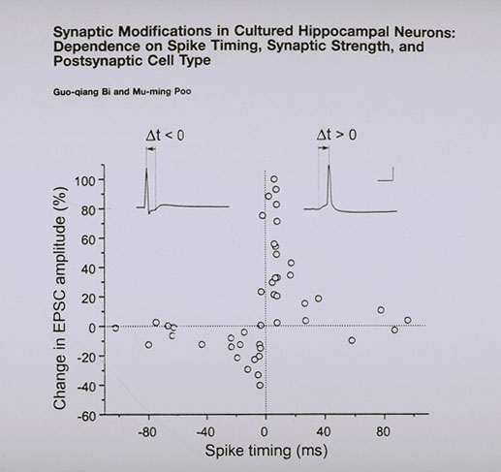
Hebbian spike timing plasticity (STDP)
hippocampal neurons
Pre before Post
Bi & Poo (1998)
Simplified:

Slide 21
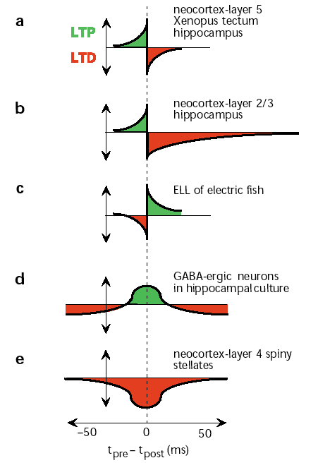
Different varieties of
Spike-timing dependent plasticity
Abbott L. and Nelson S.
Synaptic plasticity: taming the beast (2000)

Slide 22
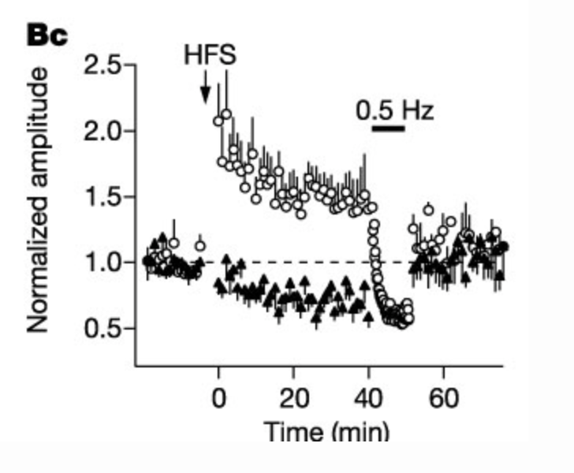
How can Hebbian networks be stable?
Heterosynaptic Long Term Depression
Royer & Pare, 2003
Decrease each w_{ij} by
Another stability rule, Oja’s rule

